Slide 1
Industrial Water Systems
Virtual Training & Assessment
Close Out Presentation

Slide 2
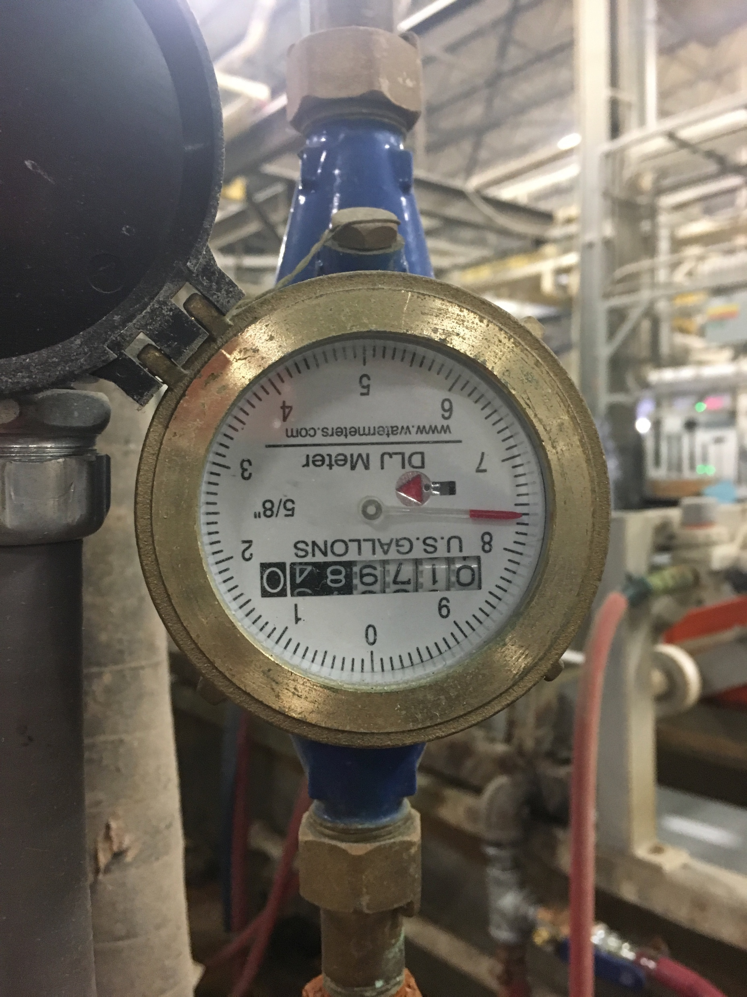
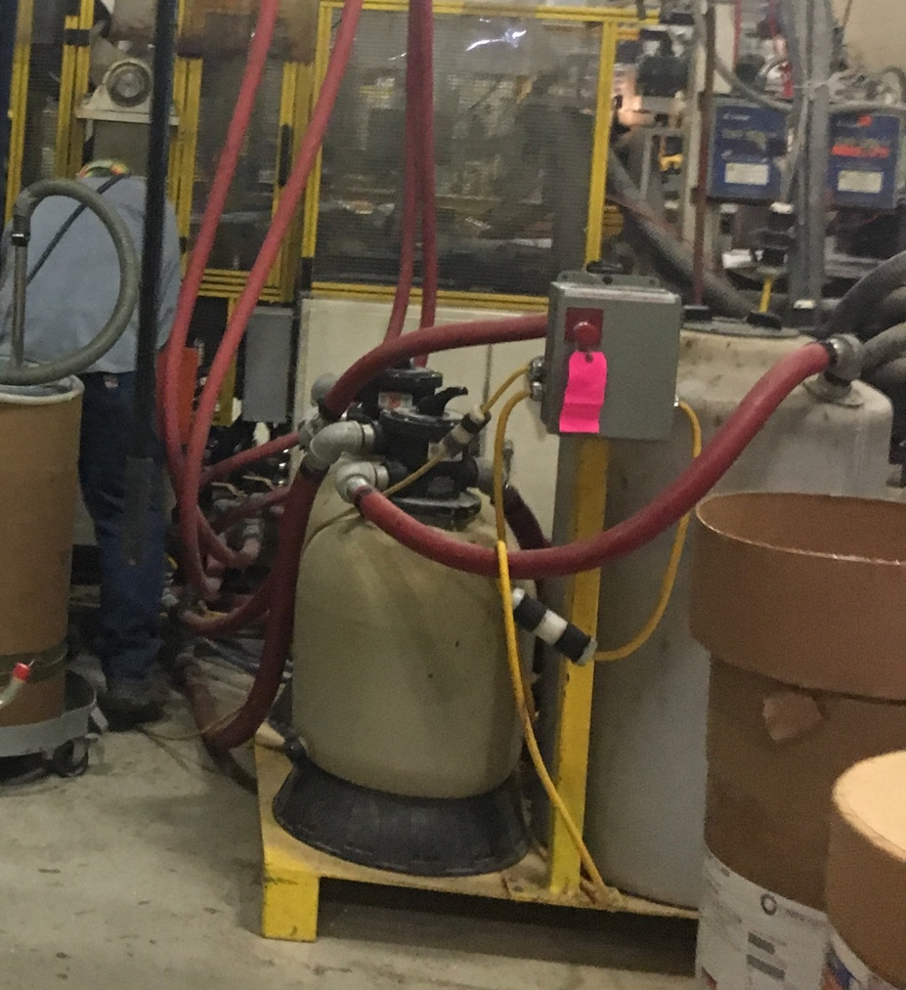
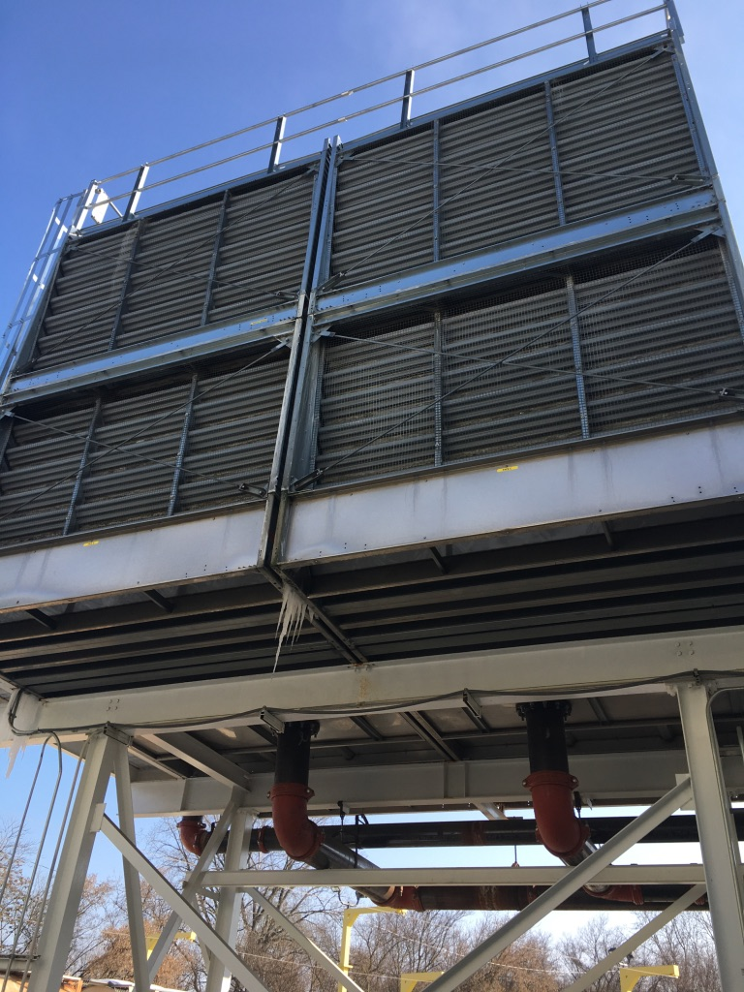
Best Practices
Water flow Metering
Recirculation System
High Cycles on Tower

Slide 3
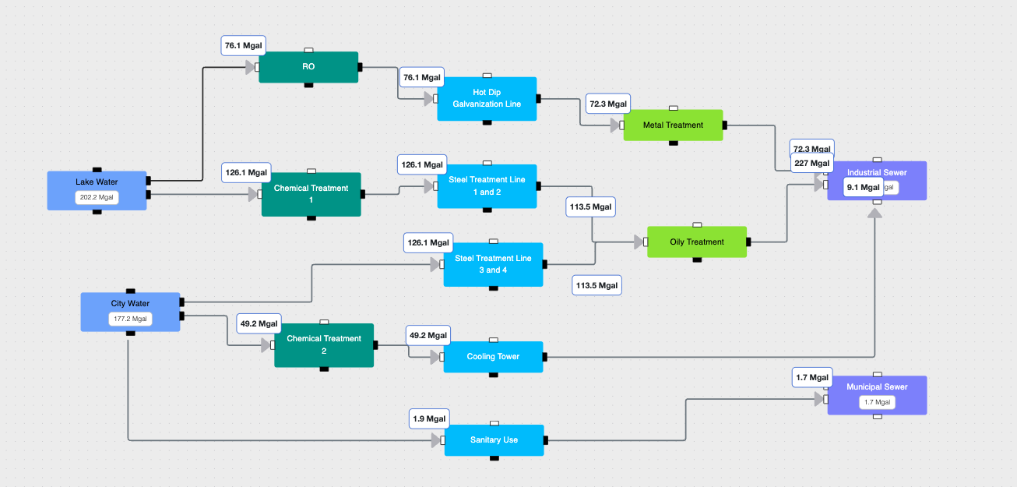
Plant Water Flows

Slide 4
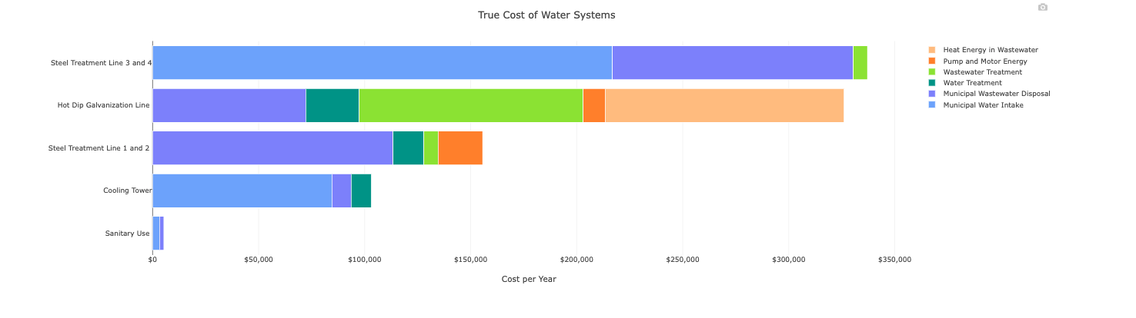
Assessment Results - True Cost of Water

Slide 5
Water Assessment – Key Conclusions
Metering production water will help understand water flows better
Water used in steel treatment is most expensive
RO brine water needs to be investigated
Pumping energy and recirculation can be reduced with better controls

Slide 6
Water Savings Opportunity
Water Treasure Hunt approach to find savings
Two teams where formed to identify opportunities
  Team 1 – Production
  Team 2 – Facility

Slide 7
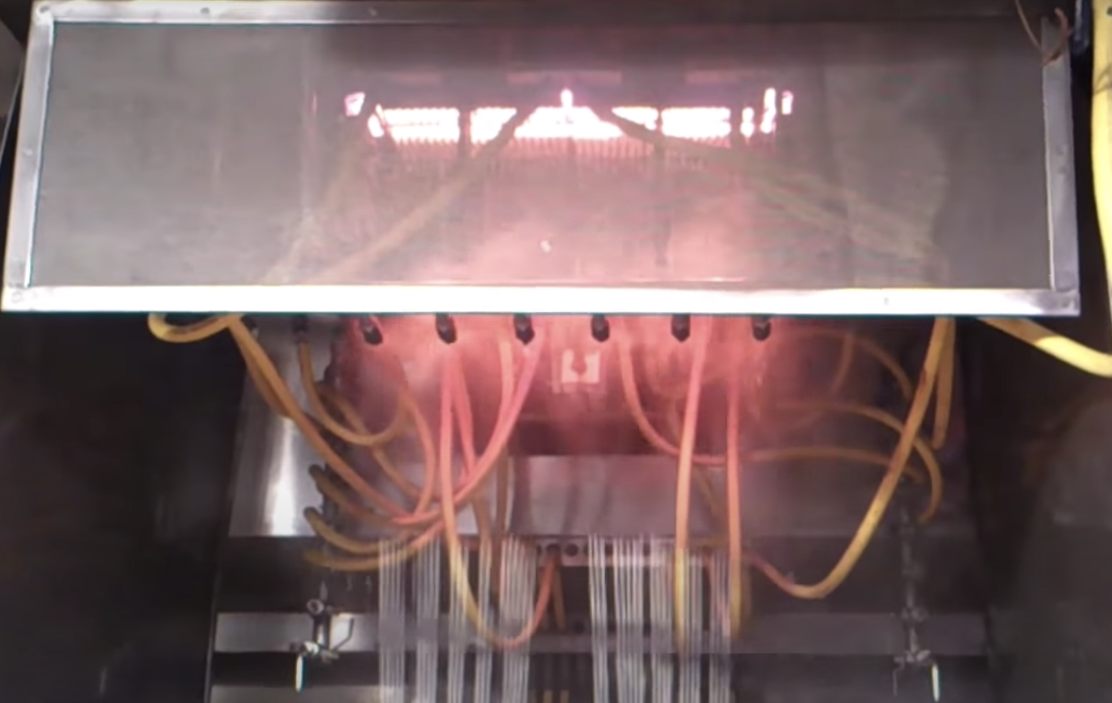
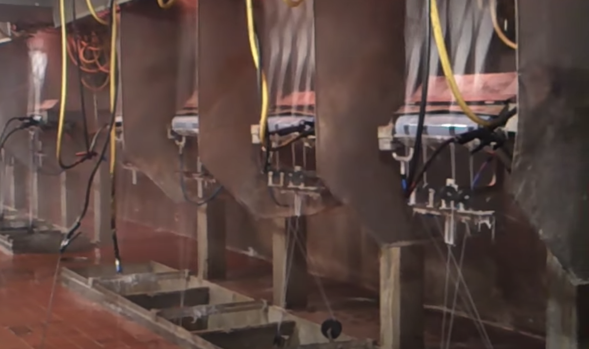
Reduce Number of Spray Nozzles per Position
It was observed that majority of nozzles spraying water at the end of positions lack contact with the glass
Opportunity:
40 MGY used in forming tunnels (from sub metering)
90% of water used in forming is from nozzle spraying (from water balance)
Water used in nozzles = 36 MGY (90% of 40 MGY)
20% reduction of nozzles can be reduced (1 per position) – by comparing it to industry standards
True cost of water = $3.5 /kgal
Potential Cost Savings = $27,527
Automated water nozzles

Slide 8
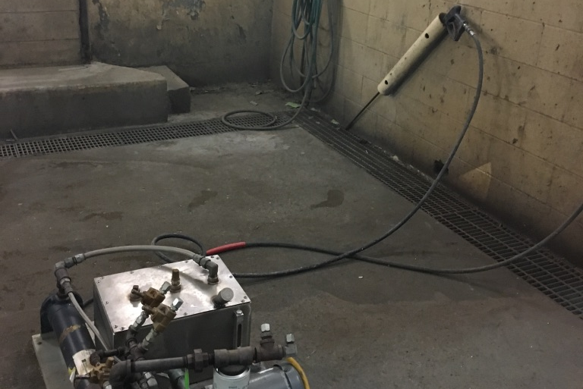
Low Flow Nozzles for Wash Bay
The wash bay uses warm pressurized water for cleaning
The flow through the nozzle is determined to be 3GPM
Using Low flow nozzles this can be cut down by half
Reduction in Water = 1.06 MGY
Estimated Cost savings = $12,000
Implementation Cost = $100
Payback = Immediate

