Slide 1
VIRTUAL PROCESS HEATING INPLT Session 8

Slide 2
Company Name:
Facility Name:
Participant Name(s):

Slide 3
Process Heating Equipment at the Facility
At our facility we use the following process heating equipment:
Pusher Furnace
Cold Mill Annealing Oven
Melter # 4
Recycle G Furnace
Soaking Pit

Slide 4
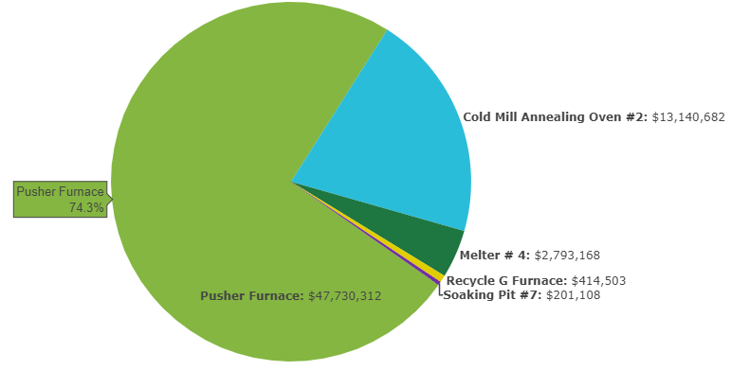
Prescreening Results
Annual Energy Use
Annual Energy Cost

Slide 5
Pusher Reheat Furnace Energy Assessment
What data measured/collected
Measured furnace wall temperatures using infrared pyrometer
Measured furnace emissions parameters using Testo 340 analyzer
Used OEM blueprints and technical specifications to get furnace information
Most data taken from active HMI screens and available historical data

Slide 6
Baseline Energy/Heat Balance

Slide 7
Energy Savings in Process Heating
Areas of Energy Use and Possible Improvements
8
10
Other Energy Losses
Control System
4
Furnace Exhaust and Heat Recovery
9
Auxiliary Systems
5
Furnace Walls
Openings Furnace Doors etc.
6
3
Heat generation Combustion System
Water or air cooling (if any)
2
Material Handling
7
1
Load/Charge Material

Slide 8
Potential Energy Saving Opportunities Identified
Raise charge material temperature into furnace
Consider possible options
Raise combustion air temperature
Return recuperator to OEM specifications
Increase air heat transfer efficiency through recuperator (updated recuperator)
Heat lost through furnace walls
Repair existing furnace refractory
Update furnace refractory material

Slide 9
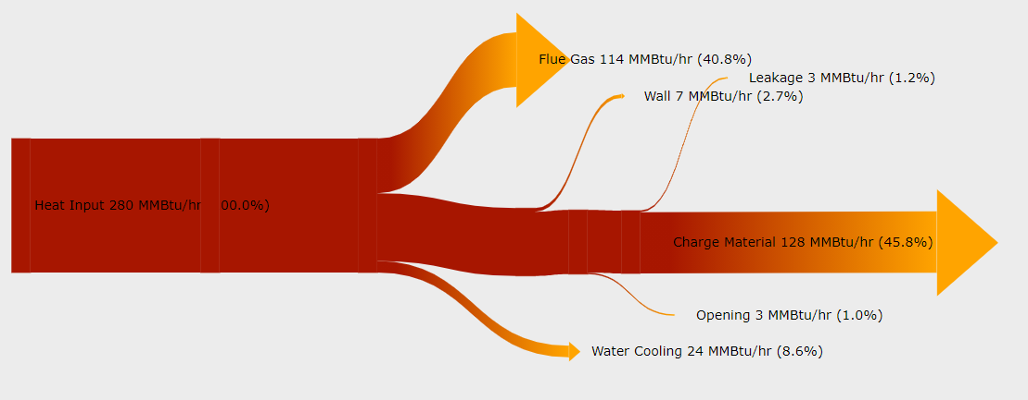
Opportunity # 1 - Raise charge material temperature into furnace
Theoretical calculations (Billet inlet average temperature 250 deg. F.)
Energy Savings 68,183 MMBTU/year
Energy Cost Savings $272,730 year

Slide 10
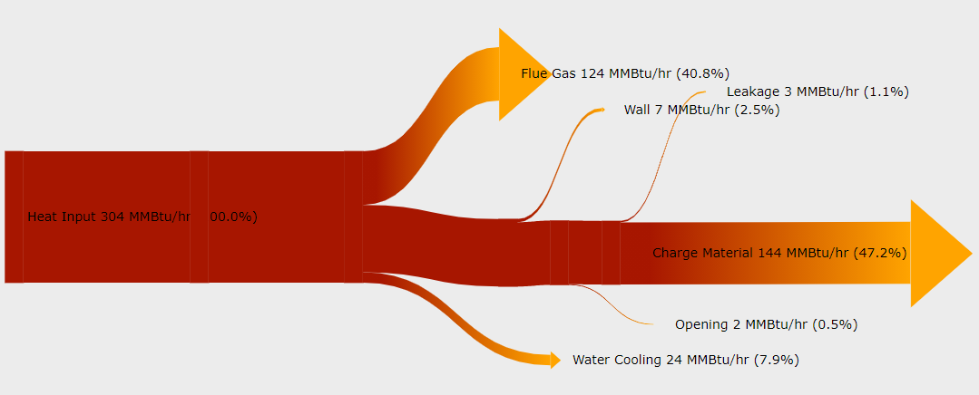
Opportunity # 2 - Raise combustion air temperature
Raise Temp from 661°F Today to 710°F OEM
Energy Savings 11,470 MMBTU/year
Energy Cost Savings $45,870 year

Slide 11
Opportunity # 3 - Reduce heat loss through walls
Reduce average wall temperature from 427°F to 200°F
Energy Savings 93,930 MMBTU/year
Energy Cost Savings $375,715 year,

Slide 12
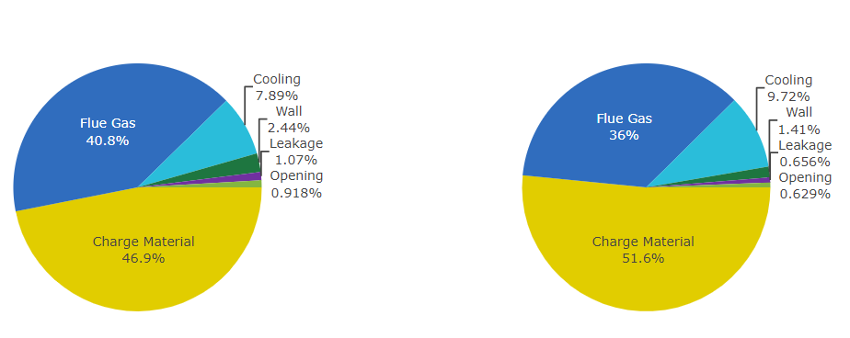
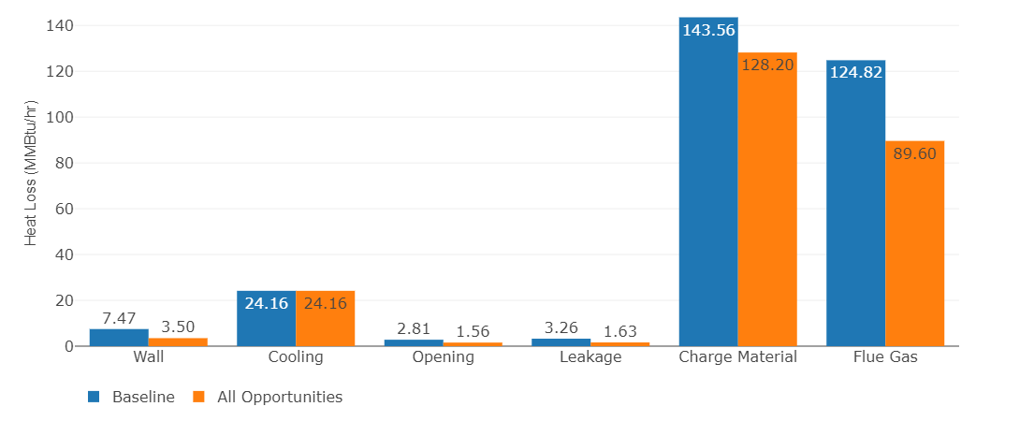
Summary of Energy Savings Opportunities
Total Savings Summary
Use graphs from the MEASUR tool

Slide 13
Next Steps or Action Items after the PH VINPLT
What are your next steps to implement opportunities?
What are you planning to do after the PH VINPLT?
Lessons learned?

Slide 14
Questions and Answers

